Slide 1
Week 8
More SQL – THE SYSTEM Catalog, AKA THE METAdATA

Slide 2
Student Objectives
Upon completion of this video, you should be able to:
Describe how a DBMS is structured
List at least 4 tables in the system catalog
List at least 3 useful queries that you could use the system catalog to help you answer
Display the tables in a database in 2 different ways.

Slide 3
System Tables
QUESTION: What do you do if you create a table and can’t remember what type a particular column is?
ANSWER: SHOW TABLES;
DESCRIBE TABLE;
QUESTION: What are some of the things (components) in a relational database:
Databases, Tables, Columns, DataTypes, Views;
QUESTION: What is another word for a thing in an ER diagram?
Entity
Notes:
Show tables;
Databases,Tables, columns, datatypes, views
Entity

Slide 4
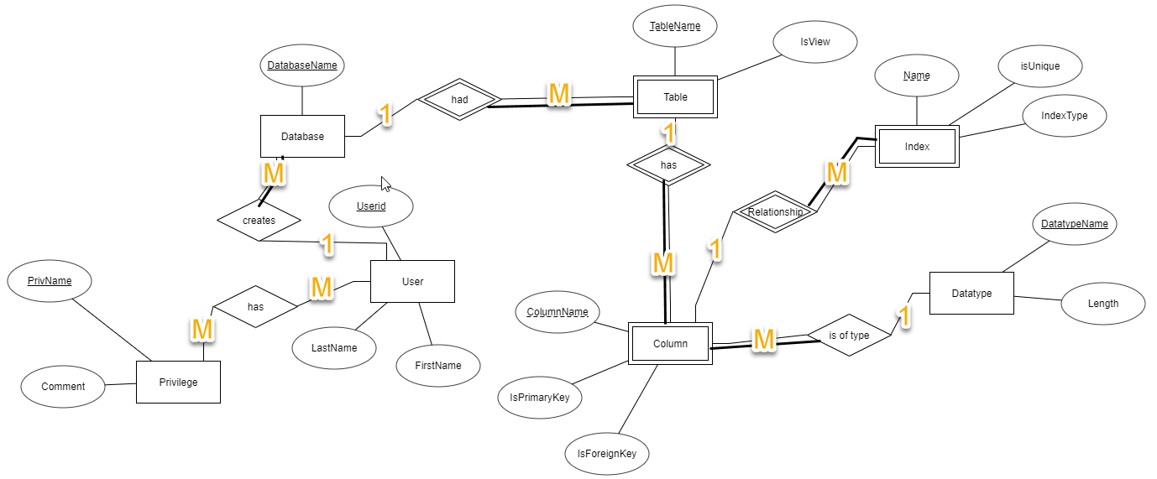
QUESTION: Draw a very simple ER diagram of a relational database:

Slide 5
QUESTION: Map your ER diagram to a relational model and fill in some of the tables with a few records:
Databases
TABLES
DatabaseName | CreatorID*
vetoffice | lreid
assign2 | lreid
Information_schema | mysql
DatabaseName* | Table_Name | Autoincrement
vetoffice | pet | No
vetoffice | owner | Yes
Information_schema | TABLES | Yes
COLUMNS
DatabaseName* | Table_Name* | Column_Name | DataType*
vetoffice | pet | petName | Varchar(40)
vetoffice | pet | petID | INT
vetoffice | pet | species | Varchar(40)
Information_schema | TABLES | Table_Name | Varchar(40)
Information_schema | COLUMNS | Table_Name | Varchar(40)
Information_schema | COLUMNS | Column_Name | Varchar(40)

Slide 6
QUESTION: How do you think MySql represents your database?
MySQL represents your databases as a bunch of tables, just like you represent your database!
These tables are called System Tables or System Catalog or Data Dictionary or Metadata or a mini database which describes your database.
System Catalog keeps track of all the table names, attribute names, attribute domains, descriptions of constraints, etc...
The Systems tables are hidden from you slightly but you can see them if you really want to ☺

Slide 7
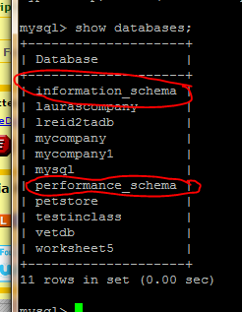
Viewing the MySql System Catalog
Notice the 2 databases circled.
You did NOT create those
They can be very useful, as you will see.
You can only read from these, you can NOT do any inserts, updates or delete operations
Need the use command → USE information_schema;

Slide 8
Try these SQL commands in MySQL on your Virtual Machine:
SHOW DATABASES;
OR
SELECT SCHEMA_NAME FROM information_schema.SCHEMATA;
OR
USE information_schema;
SELECT SCHEMA_NAME FROM SCHEMATA;
SELECT * FROM SCHEMATA;

Slide 9
QUESTION: so what does the SCHEMATA table hold?
ANSWER: all our databases (a row for each database)
QUESTION: What is the SCHEMA_NAME?
ANSWER: the UNIQUE name of each database (the primary key for this table!)

Slide 10
Now try this…
SHOW TABLES;
OR
SELECT table_name FROM information_schema.tables;
OR
USE information_schema;
SELECT table_name FROM tables;
SELECT * FROM tables; (watch what happens with this command)

Slide 11
Question: how would you only show the table names in a particular database?
To figure this out, do this command first:
SELECT * FROM information_schema.TABLES;
Then consider how you would modify this command to show just the tables in the vetoffice database?
SELECT table_name FROM information_schema.TABLES
WHERE table_schema = “vetoffice”;
Notes:
select TABLE_NAME from information_schema.TABLES where TABLE_SCHEMA = ‘petoffice’;

Slide 12
Type of information you can get from the System Catalog:
This command:
SELECT table_name FROM information_schema.TABLES WHERE table_schema = 'information_schema'; returns this:
+---------------------------------------+
| TABLE_NAME |
+---------------------------------------+
| CHARACTER_SETS |
| COLLATIONS |
| COLLATION_CHARACTER_SET_APPLICABILITY |
| COLUMNS |
| COLUMN_PRIVILEGES |
| ENGINES |
| EVENTS |
| FILES |
| GLOBAL_STATUS |
| GLOBAL_VARIABLES |
| KEY_COLUMN_USAGE |
| PARAMETERS |
| PARTITIONS |
| PLUGINS |
| PROCESSLIST |
| PROFILING |
| REFERENTIAL_CONSTRAINTS |
| ROUTINES |
| SCHEMATA |
| SCHEMA_PRIVILEGES |
| SESSION_STATUS |
| SESSION_VARIABLES |
| STATISTICS |
| TABLES |
| TABLESPACES |
| TABLE_CONSTRAINTS |
| TABLE_PRIVILEGES |
| TRIGGERS |
| USER_PRIVILEGES |
| VIEWS |
| INNODB_BUFFER_PAGE |
| INNODB_TRX |
| INNODB_BUFFER_POOL_STATS |
| INNODB_LOCK_WAITS |
| INNODB_CMPMEM |
| INNODB_CMP |
| INNODB_LOCKS |
| INNODB_CMPMEM_RESET |
| INNODB_CMP_RESET |
| INNODB_BUFFER_PAGE_LRU |
+---------------------------------------+

Slide 13
All the information schema views are created when a database is created with the CREATE DATABASE command
The catalog views and tables CANNOT be explicitly dropped or created
The catalog views and tables are updated as you perform SQL commands.

Slide 14
Question: Which of the following 2 commands do you think will update the catalog tables/view?
INSERT INTO pet VALUES (“dog”,”Scruffy”,22);
ALTER TABLE pet ADD COLUMN weight INT;
How could we check?
SELECT * FROM information_schema.columns WHERE table_name = 'pet';

Slide 15
Why are System/Catalog tables useful?
What if you want to see which tables are really big (more than a given number of rows?)
SELECT CONCAT(table_schema, ‘.’ ,table_name) as table_name, table_rows FROM information_schema.tables WHERE table_rows > 1000 AND table_schema not in('information_schema','mysql','performance_schema') ORDER BY table_rows desc;
+----------------------------------+------------+
| table_name | table_rows |
+----------------------------------+------------+
| customers.orders | 2007 |
| customers.contact_info | 1245 |
| customers.rewards_points | 2147 |
| business_contacts.company_info | 1340 |
| business_contacts.phone_numbers | 1712 |
| sonar.project_measures | 178618 |
| sonar.resource_index | 110328 |
| sonar.rule_failures | 40793 |
+----------------------------------+------------+

Slide 16
Other things you could do
Write a query to list all the tables without a primary key
SELECT t.table_name FROM tables t LEFT JOIN TABLE_CONSTRAINTS tc ON t.table_schema = tc.table_schema AND t.table_name = tc.table_name AND constraint_type='PRIMARY KEY' WHERE tc.constraint_name IS NULL AND t.table_type='BASE TABLE‘;
Find the top 5 largest tables in a database
SELECT table_schema, table_name, data_length FROM tables ORDER BY data_length DESC LIMIT 5;

